Slide 1
The Religious Heterogeneity of Nones
Simon Brauer, Ph.D.
sb2ts@virginia.edu
www.simonbrauer.us

Slide 2
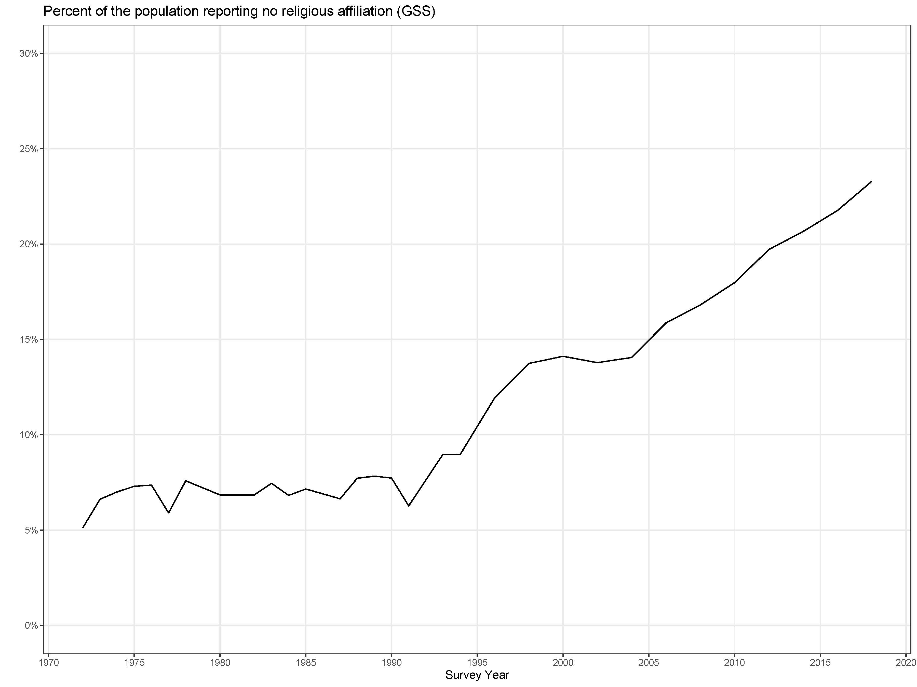
Notes:
Follows Pews quite well; with about 5% each of atheist and agnostic in their aggregated political survey data

Slide 3
Who are the Nones?
Demographics and network
Young*
Politically liberal/Democratic*
Have less-religious families and friends
Less-likely to be married or have children*
BUT
“It is a mistake to view the nonreligious as a homogeneous group sharing a coherent worldview.” (Smith and Cragun 2019)
*Consistent differences across time, Strawn 2019
Notes:
Pew;
Baker and Smith (on less religious family and friends)

Slide 4
The religious lives of Nones
Manning (2013): Three types of unaffiliated
Unchurched believers (declining; Manning 2015)
Secular unaffiliated
Seeker spirituality
Drescher
Spirituality embedded in relationships
More flexible, “cosmopolitan spirituality
Community membership is provisional, not traditional

Slide 5
Questions
How religiously homogenous are US Nones overall?
How homogenous are US Nones compared to other religious traditions?

Slide 6
Approach

Slide 7
Parametric options
Models of the outcome and variance
Stronger assumptions
Weaker assumptions
Normal
Ordinal/Cumulative
Multinomial
Models of the change across time
Stronger assumptions
Weaker assumptions
Linear
Polynomial
Spline
Moving average or autoregressive
Independent observation

Slide 8
Measures of homogeneity
Herfindahl Index
“The probability of bumping into two people in a crowd (at random) who have the same religiosity”
$$herfindahl= \sum_{k=1}^{K}{p_{k}^{2}}$$
Entropy
Used in information theory and criteria (e.g. AIC, BIC, DIC)
$$entropy=−\sum_{k=1}^{K}{p_{k}ln⁡(p_{k})}$$

Slide 9
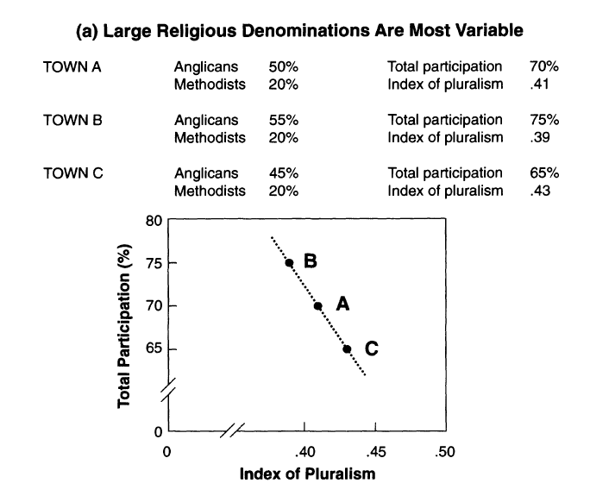
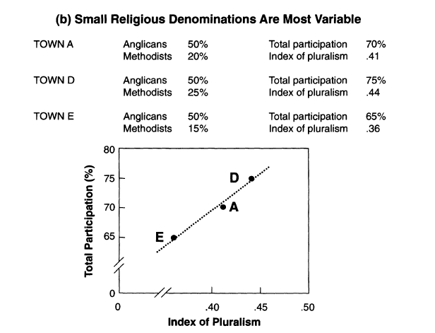
Voas, Crockett, Olson. 2002. “Religious Pluralism and Participation: Why Previous Research is Wrong.” p. 216

Slide 10
Characteristics of the Herfindahl index
For K levels of the outcome variable…
Lower bound (maximum diversity): $\frac{1}{K}$
Upper bound (minimum diversity): $1$

Slide 11
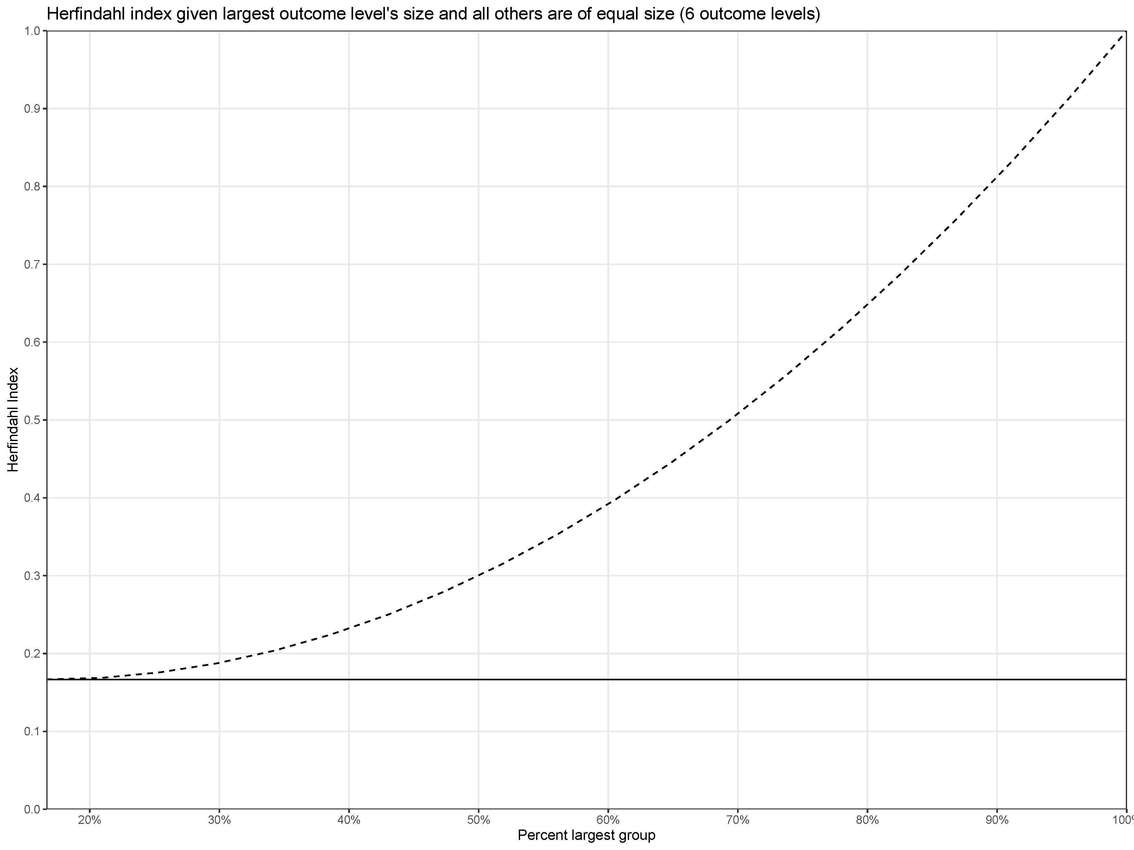
Less diverse
$$Δ=0.41$$
$$Δ=0.13$$
More diverse

Slide 12
Characteristics of the Herfindahl index
For K levels of the outcome variable…
Lower bound (maximum diversity): $\frac{1}{K}$
Upper bound (minimum diversity): $1$
Bias
Upwardly biased and skewed near maximum diversity

Slide 13
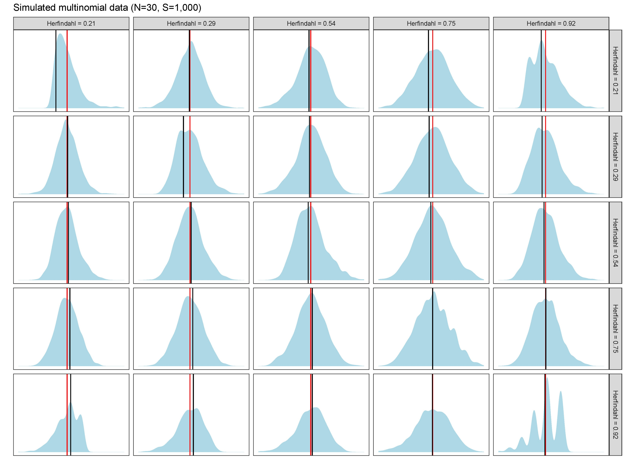

Slide 14
Characteristics of the Herfindahl index
For K levels of the outcome variable…
Lower bound (maximum diversity): $\frac{1}{K}$
Upper bound (minimum diversity): $1$
Bias
Upwardly biased and skewed near maximum diversity
Less biased and more symmetrical when comparing two groups

Slide 16
Survey Measures, General Social Survey
Grouping
RELTRAD [7]
Outcomes
Frequency of religious service attendance [9]
Frequency of prayer* [5]
Beliefs about God/higher power [6]
Beliefs about the Bible [4]
Controls
Sex [2]
Race [3]
Education (highest degree) [5]
Region [9]

Slide 17
Model
What does this mean?
$$Y_{tri} \sim Multinomial\left(p_{tr}\right)$$
$$p_{tr}\sim Dirichlet({30×p}_{t+1,r})$$
$$p_{tr}=softmax(α_{tr}+X_{tr}β_{r})$$
Where
$$t=time \\ r=religion \\ i=observation \\ p_{tr}\text{is} \text{a} \text{vector} \text{of} \text{probabilities}\text{, }\text{length} K \\ α \text{is} \text{a} \text{time}\text{−}\text{varying} \text{intercept} \\ X \text{is} \text{a} N×K \text{matrix} \text{of} \text{controls} \text{at} \text{time} t \\ β \text{is} \text{a} K×1 \text{matrix} \text{of} \text{time}\text{−}\text{constant} \text{coefficients}$$
Multinomial model
Each religious tradition is modelled separately
Controls have constant effects across time, but vary by religion
Each year has its own set of probabilities
Probabilities are shrunk towards those of the next observed year, as if there were 30 additional observations from the next year in the current year

Slide 18
Results

Slide 19
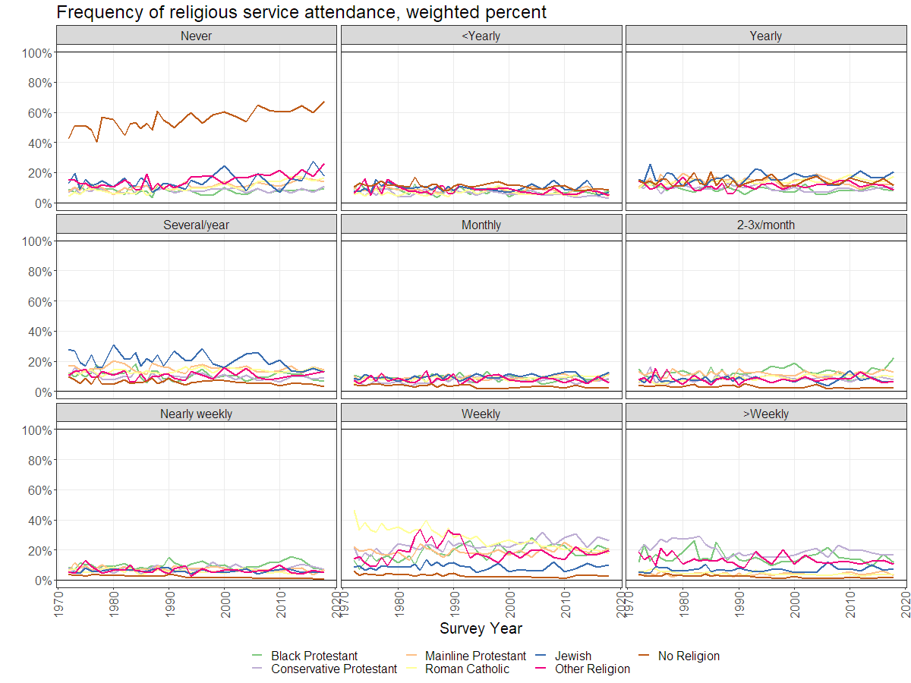
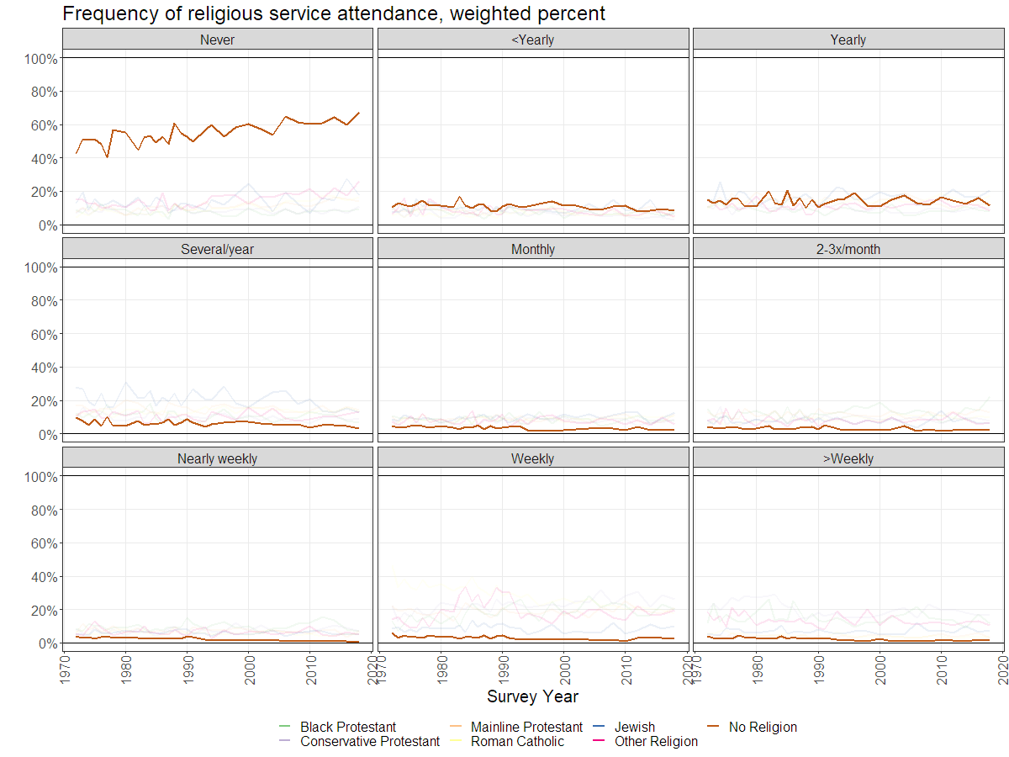
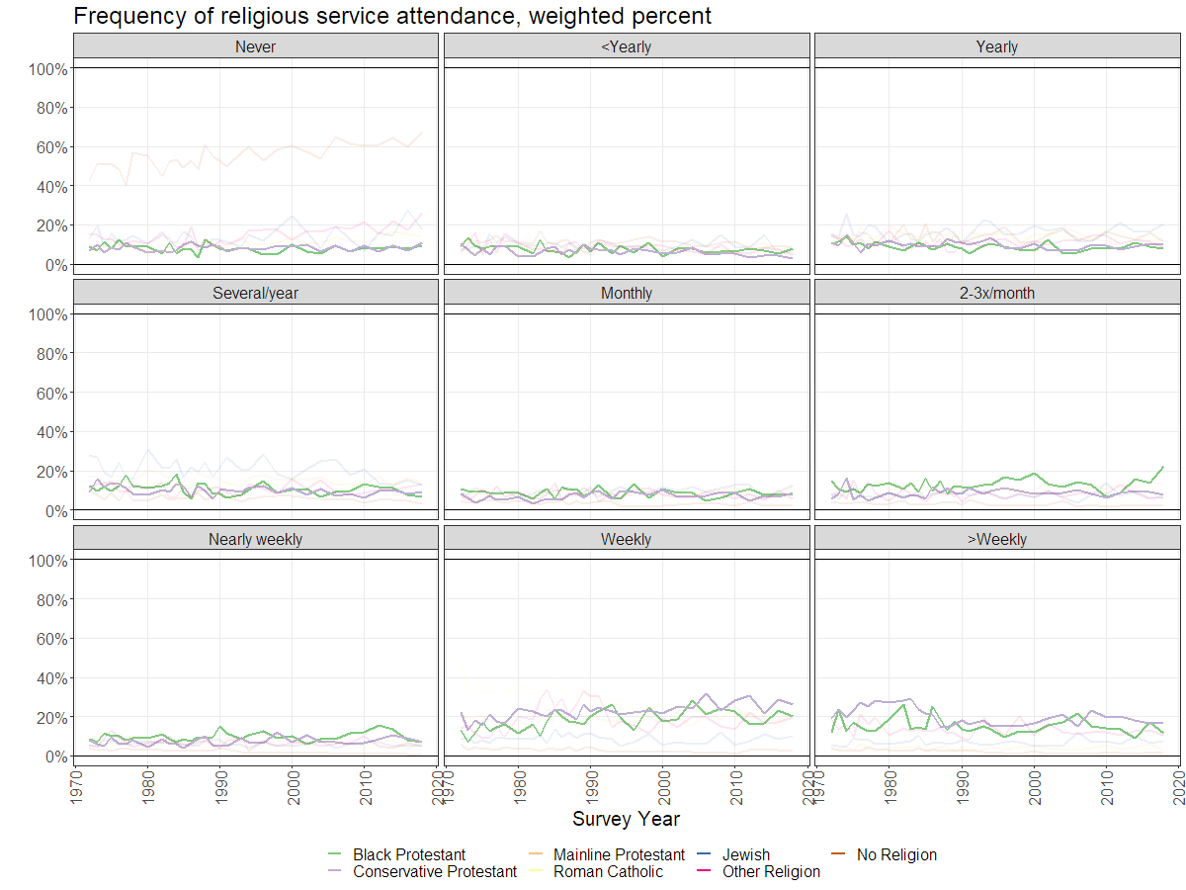
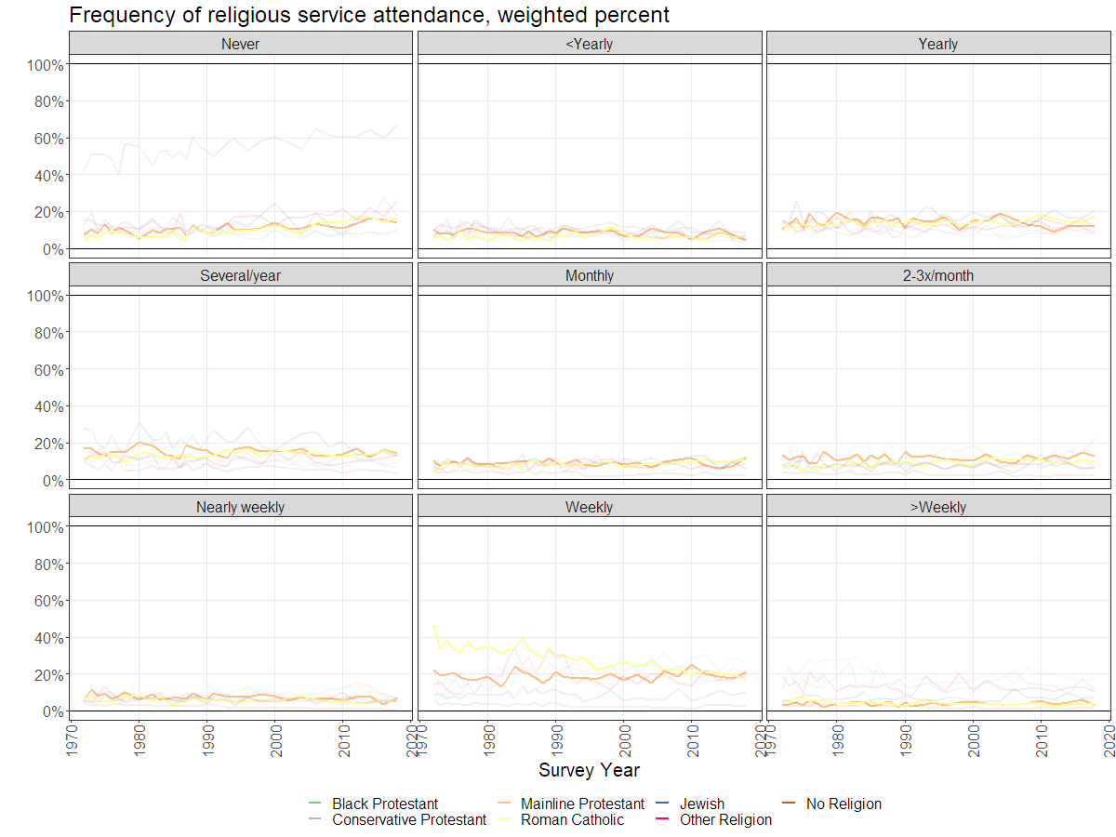
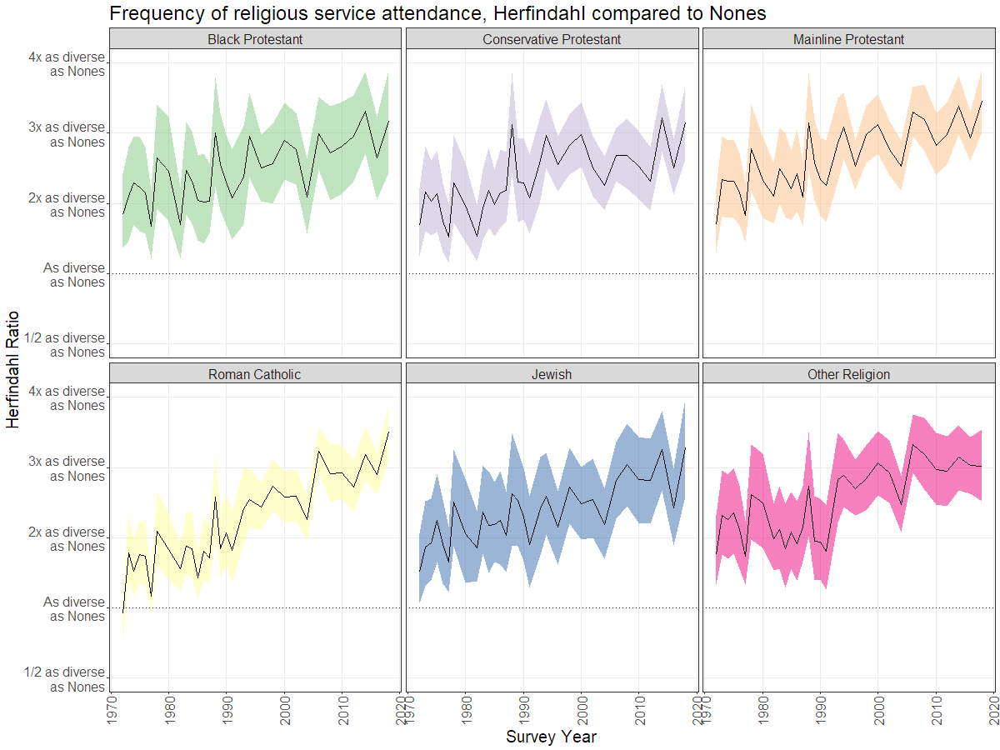
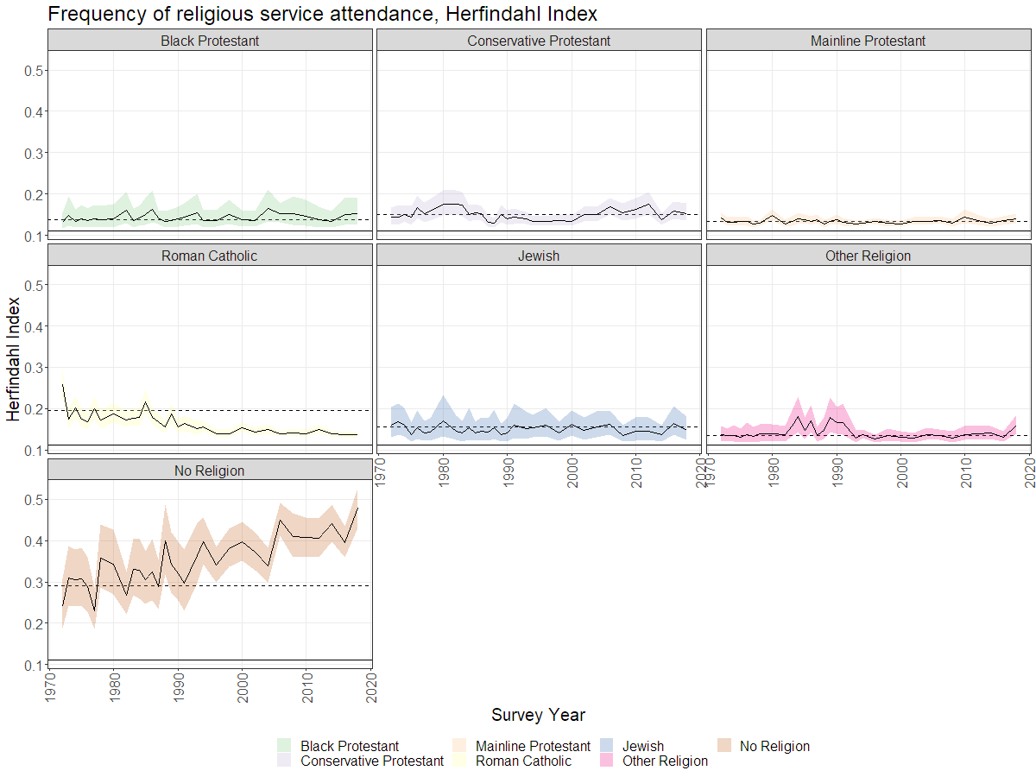
Frequency of religious service attendance
0.25
0.45

Slide 20
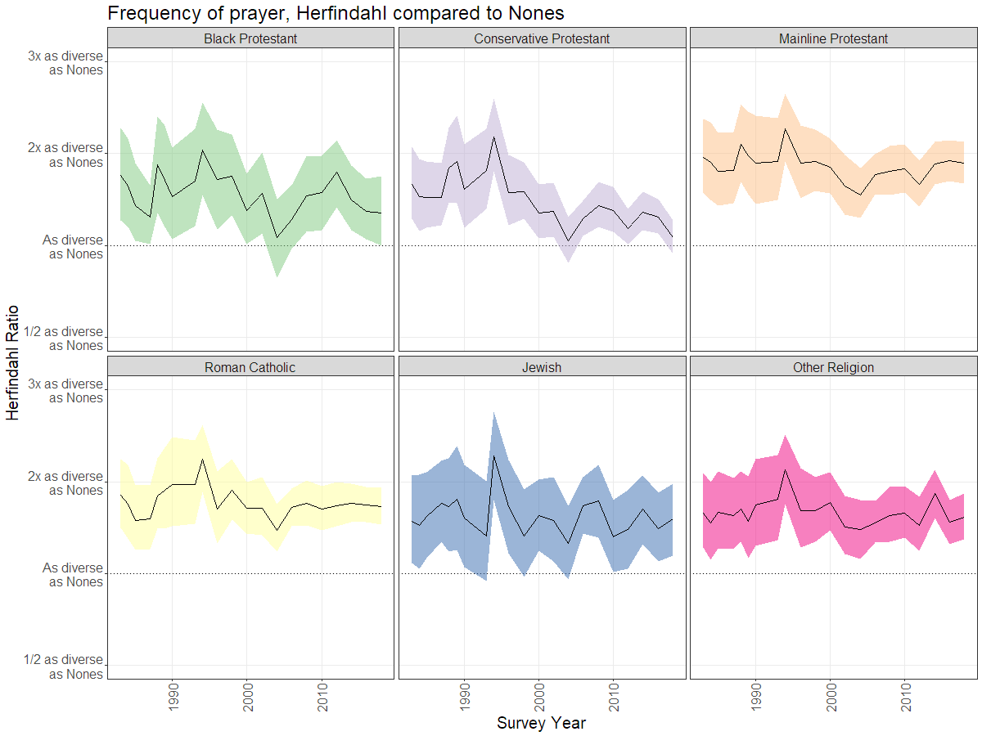
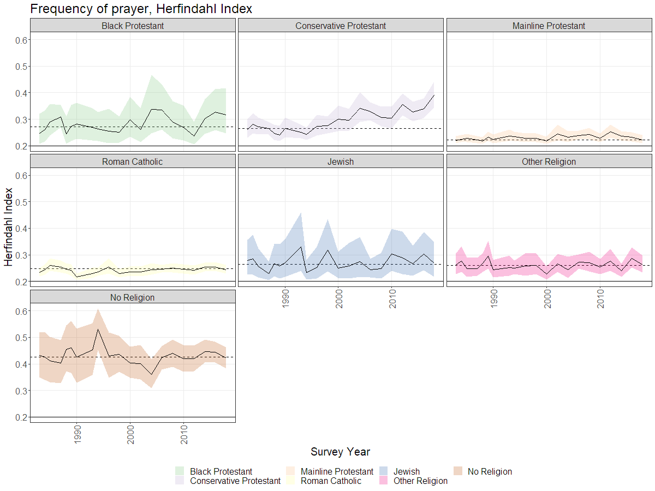
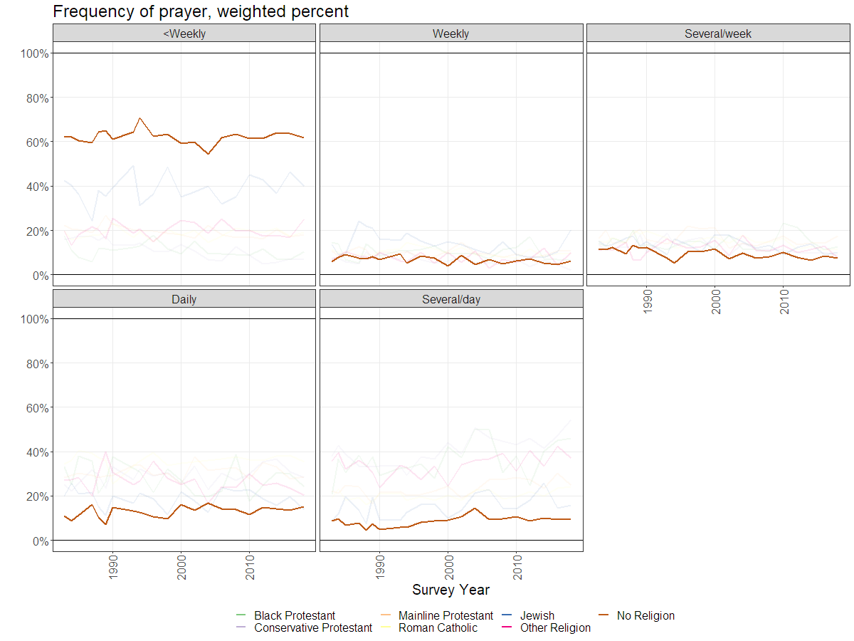
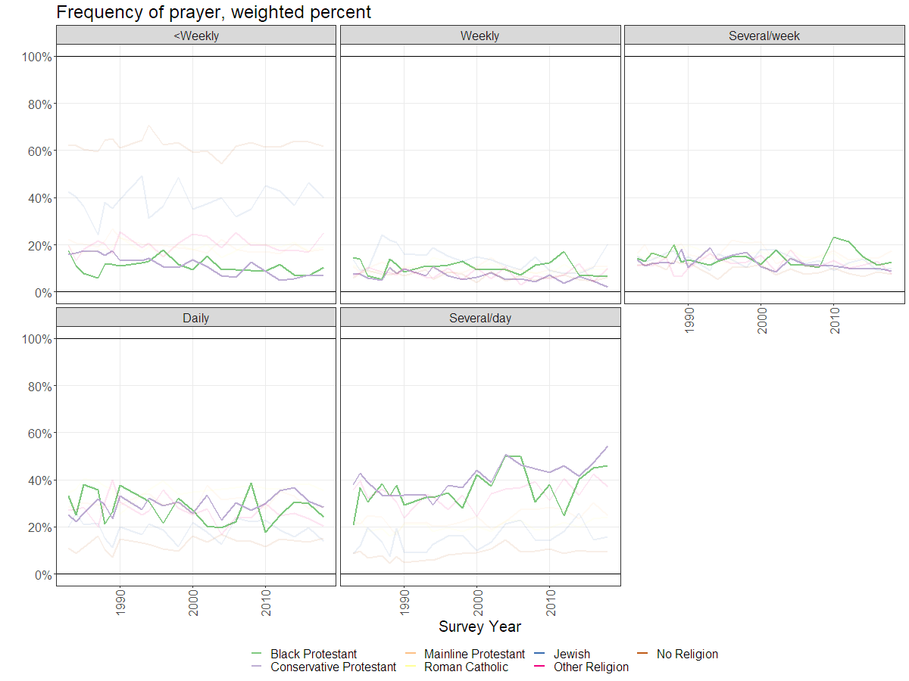
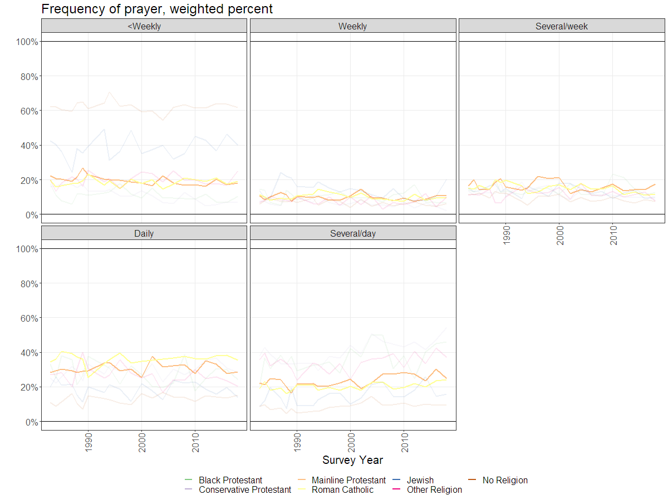
Frequency of prayer
0.42
0.42

Slide 21
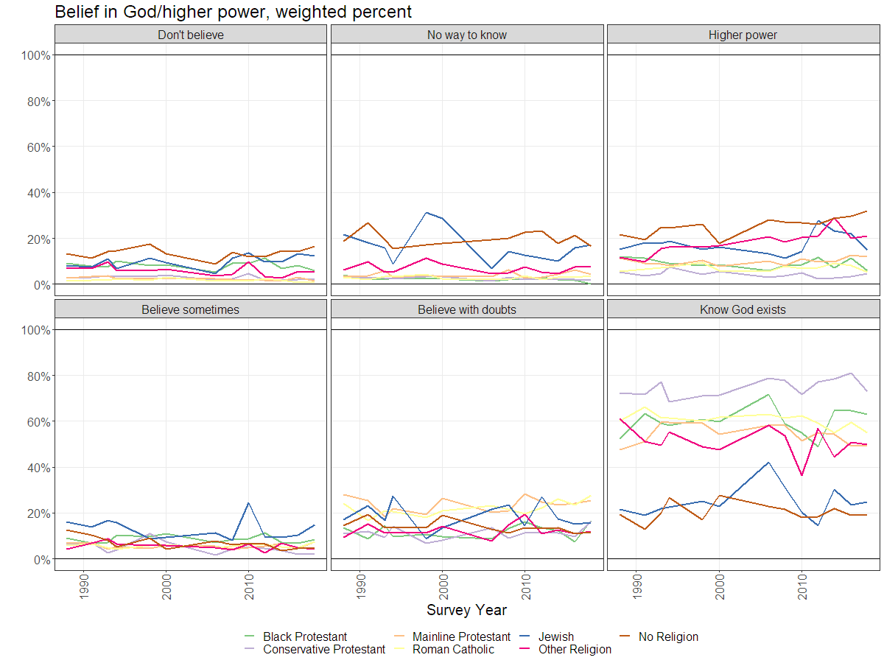
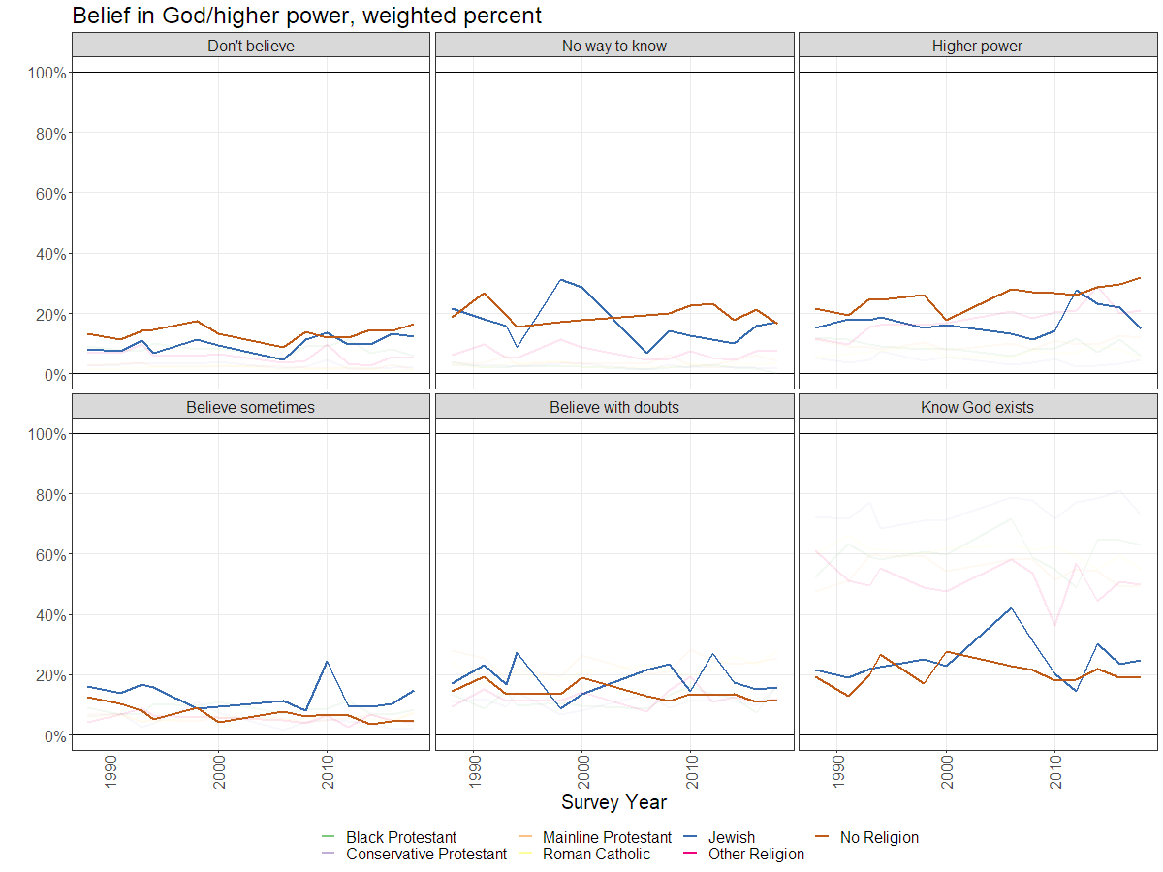
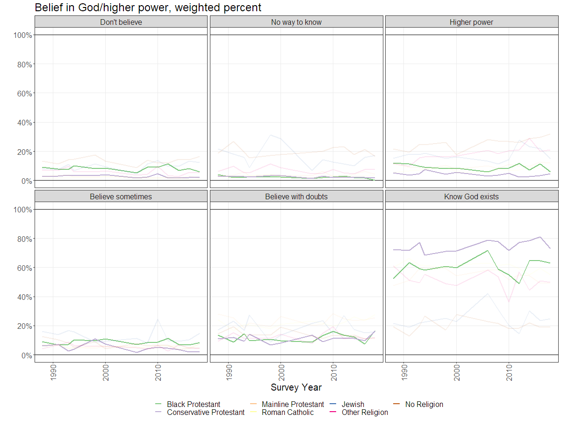
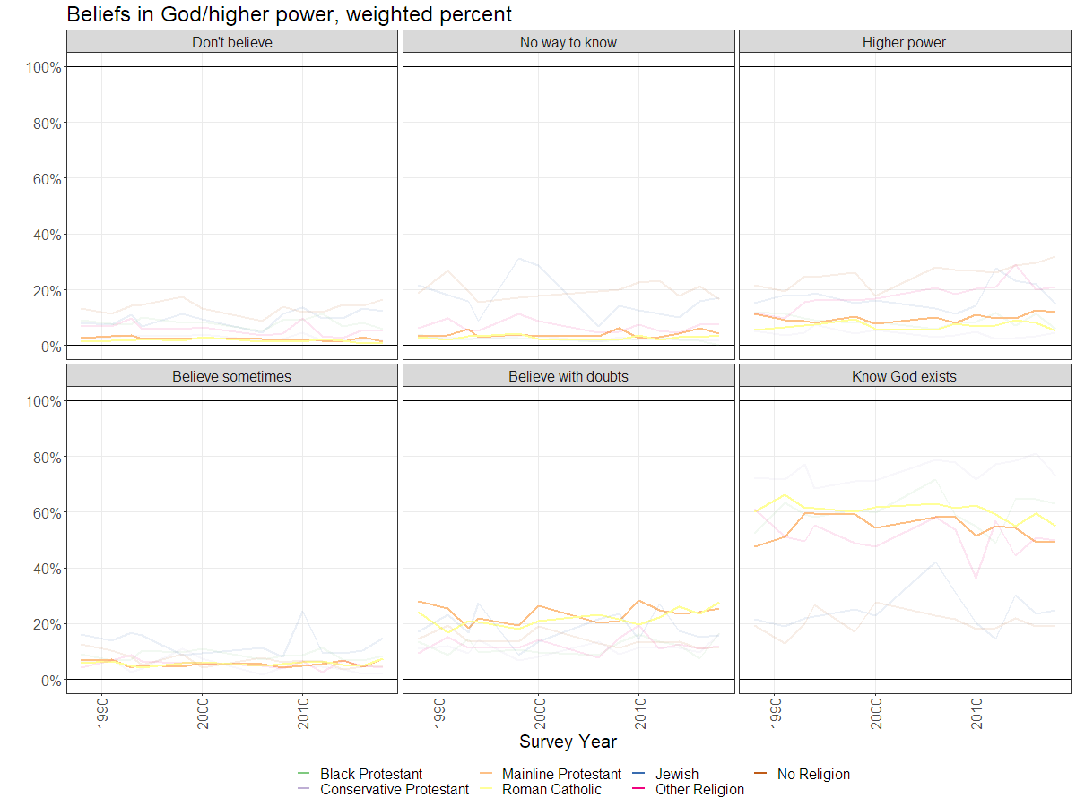
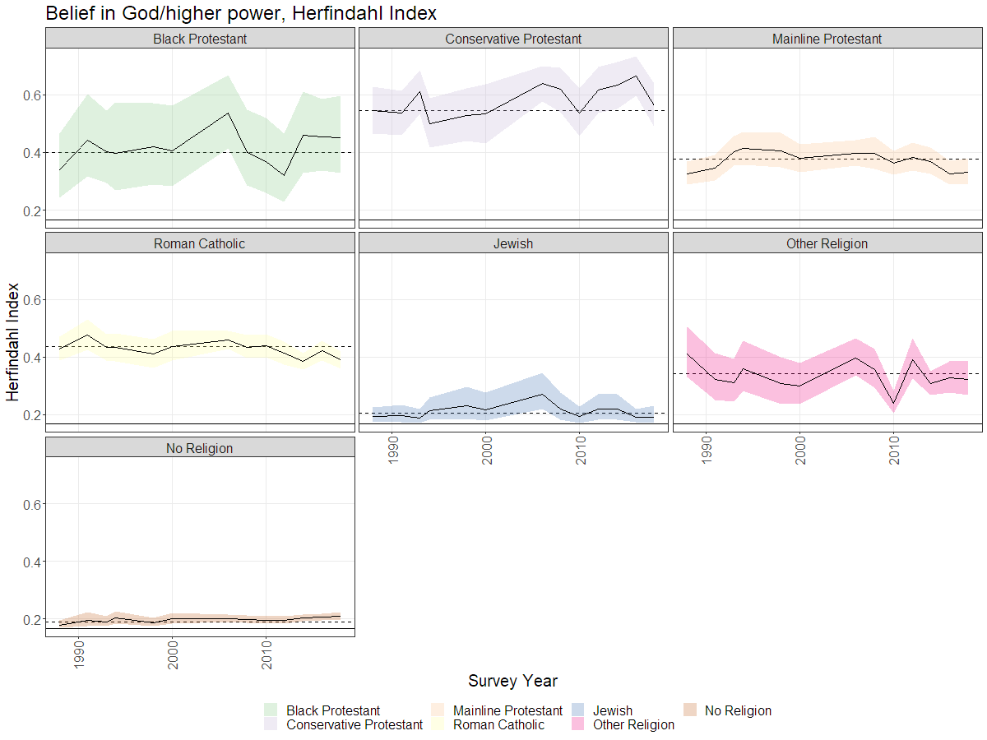
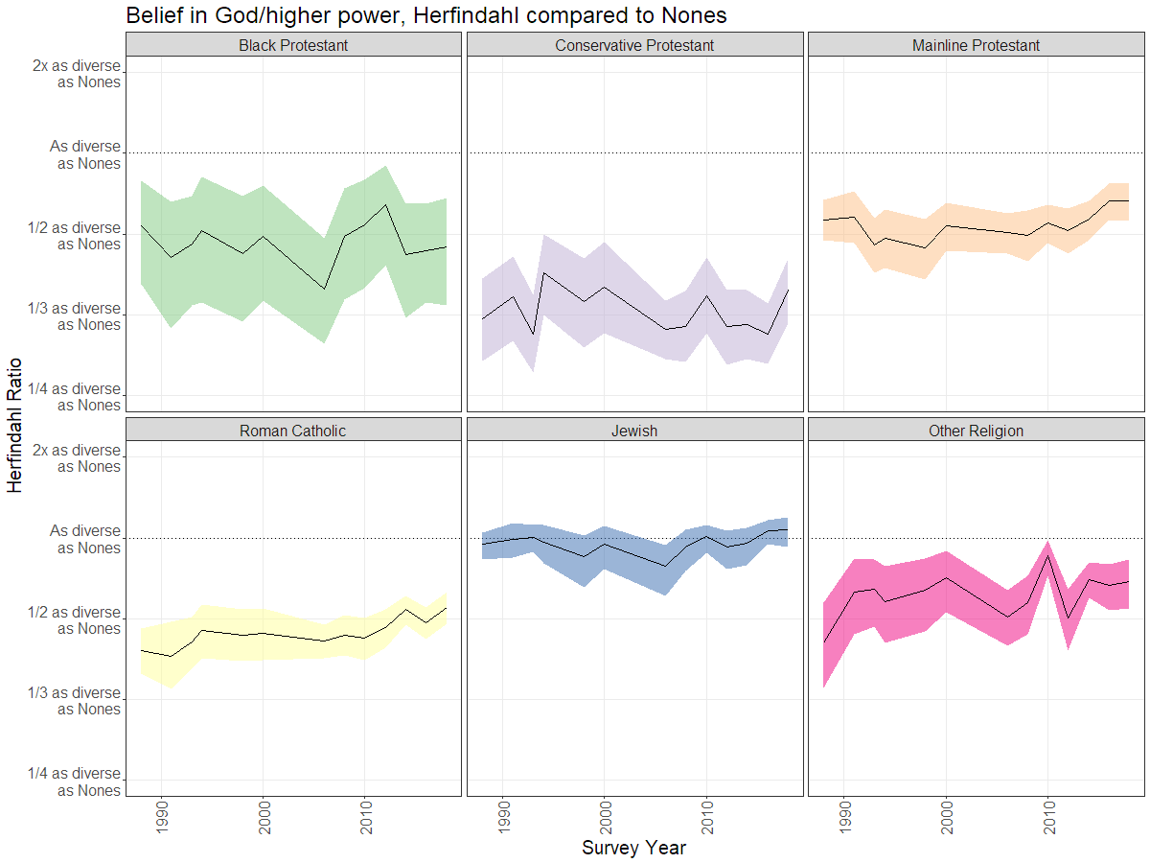
Belief in God/higher power
0.2
0.2

Slide 22
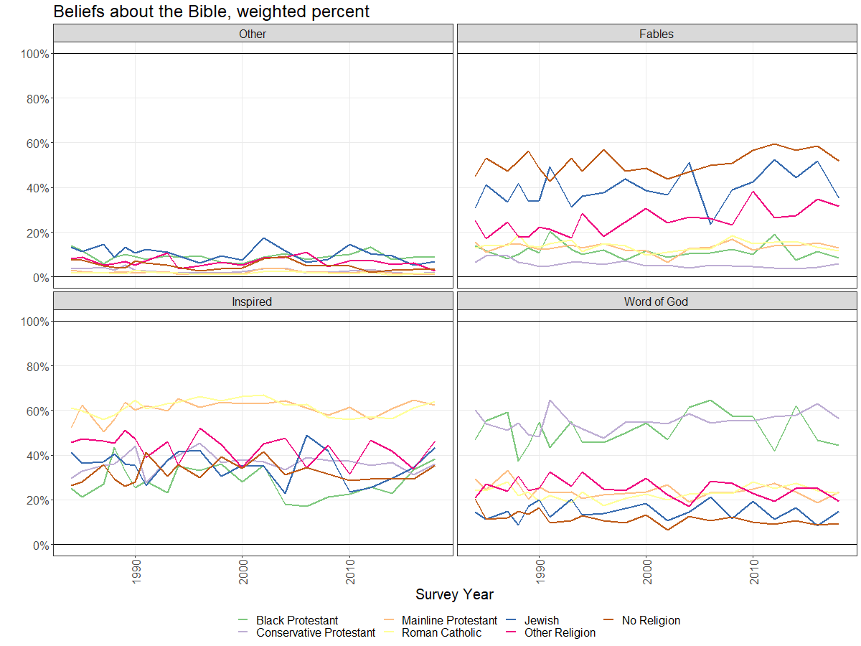
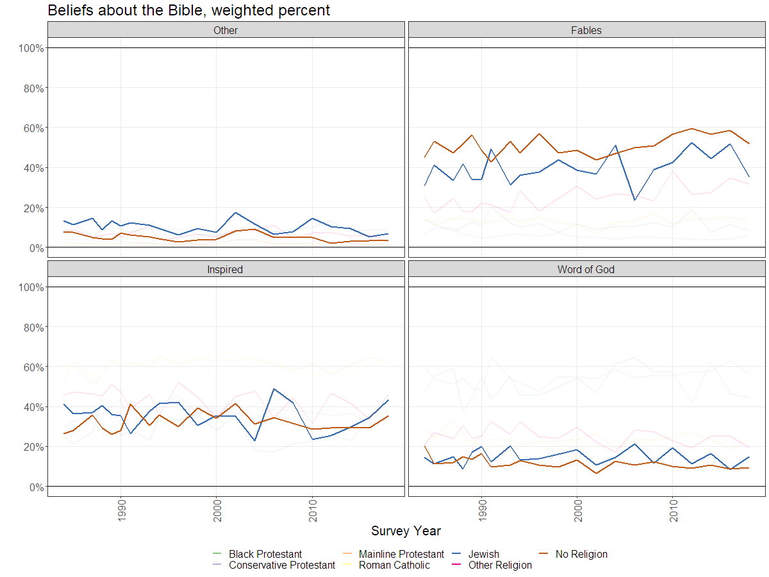
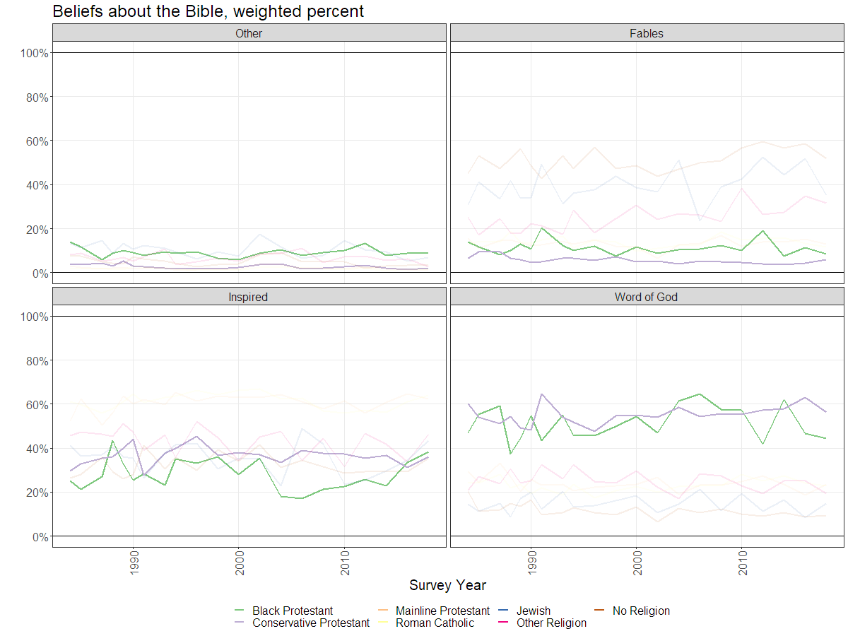
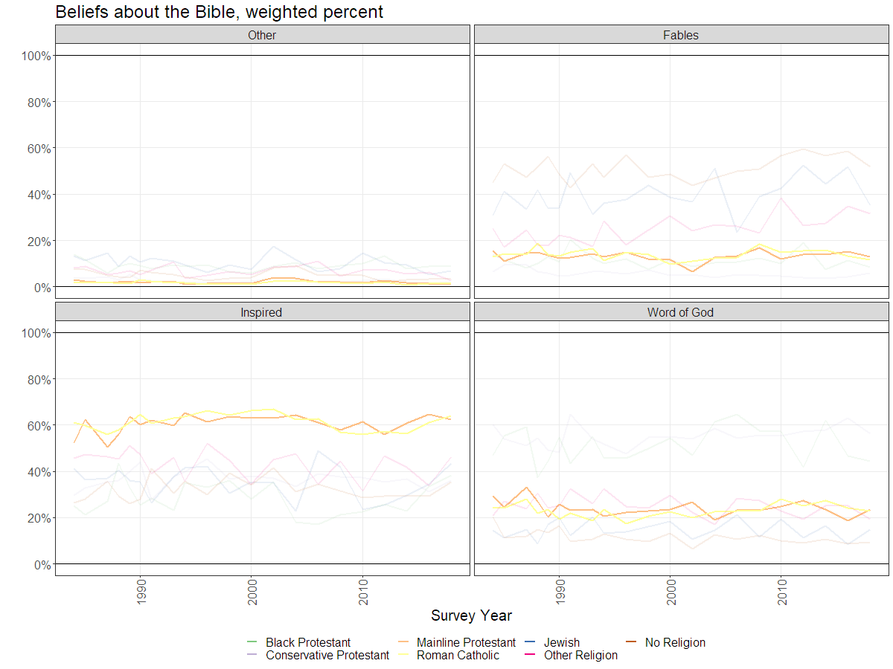
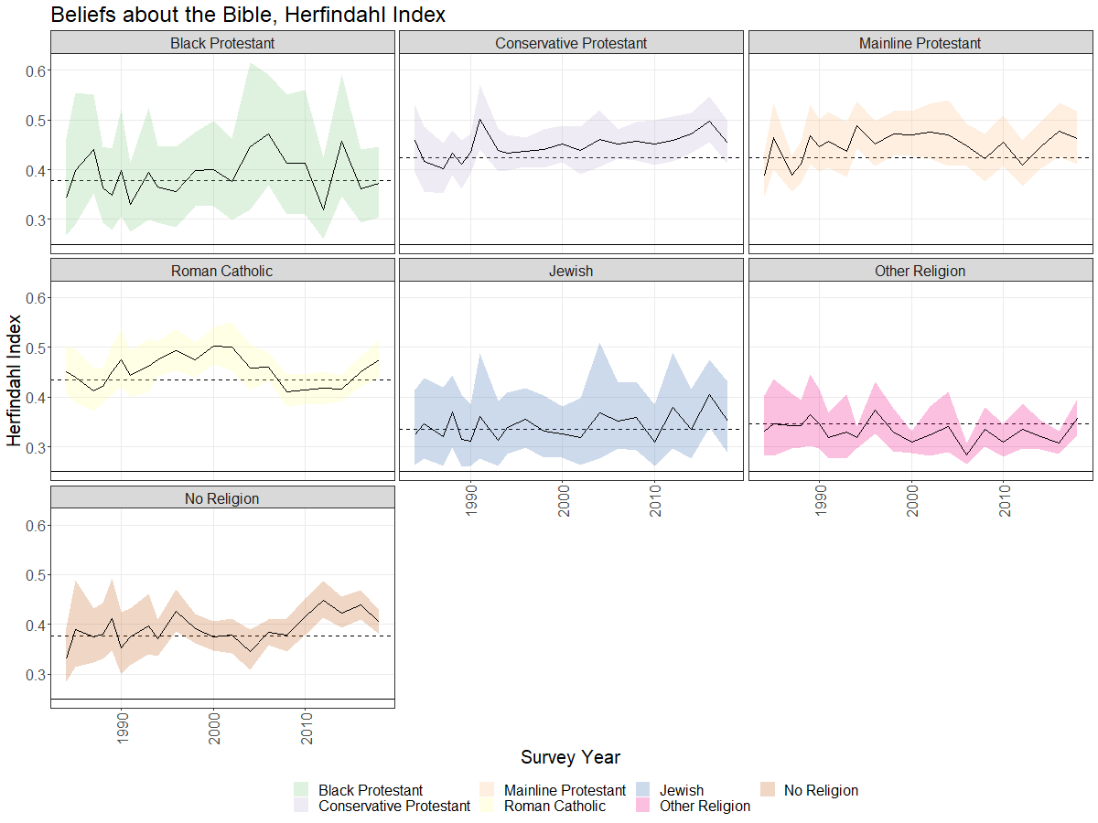
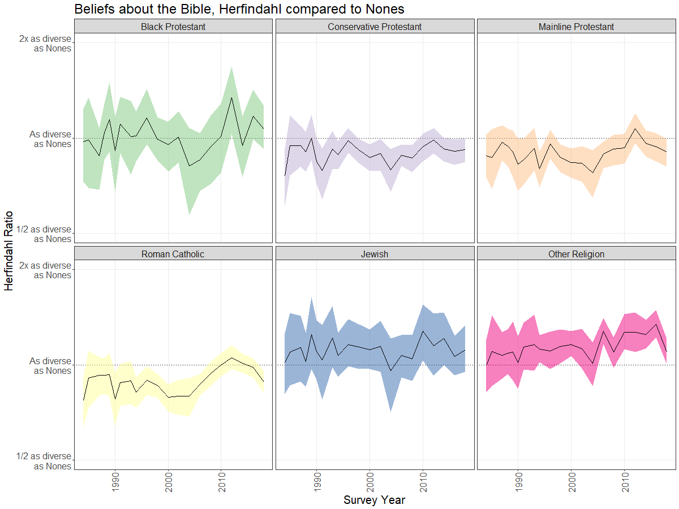
Beliefs about the Bible
0.35
0.42

Slide 23
Conclusions
How religiously homogenous are US Nones overall?
Moderately homogenous on behaviors and the Bible (~0.4 in recent years)
How homogenous are US Nones compared to other religious traditions?
More homogenous than others behaviorally
Just as heterogeneous as others on belief about the Bible
More heterogeneous than most others on belief about God

Slide 24
What does it mean?
Reiterates a distinction between behavioral/ organizational aspects of religion and belief
Not-surprisingly, theologically-specific questions (e.g. Bible) see less diversity than less-specific questions (e.g. God)
Diversity of belief may present a unique challenge to the organization of non-religion (see Smith and Cragun 2019)

Slide 25
Thank you
Simon Brauer, Ph.D.
sb2ts@virginia.edu
www.simonbrauer.us

Slide 26
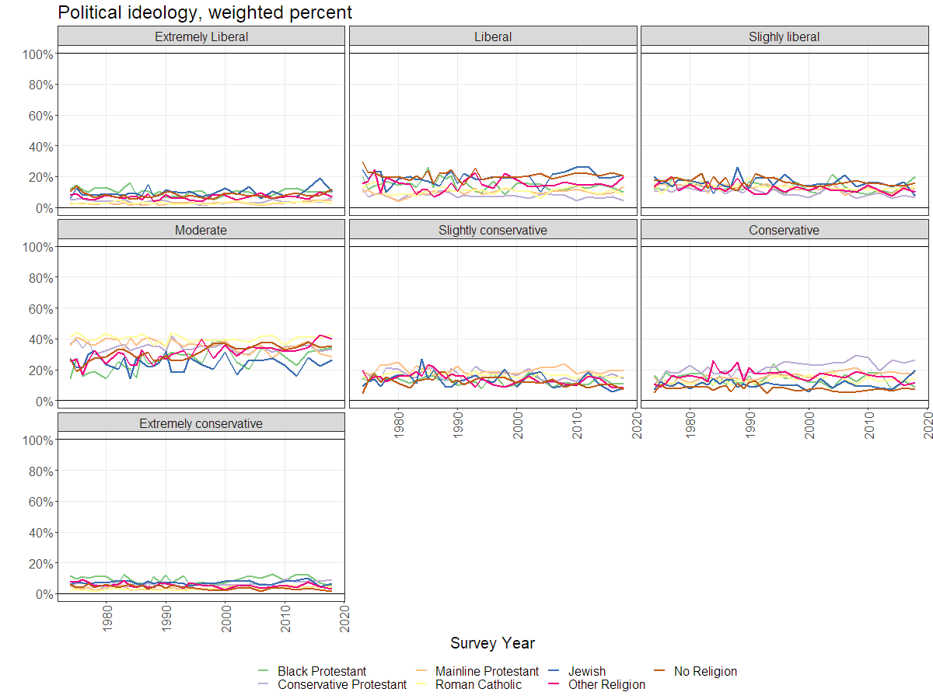
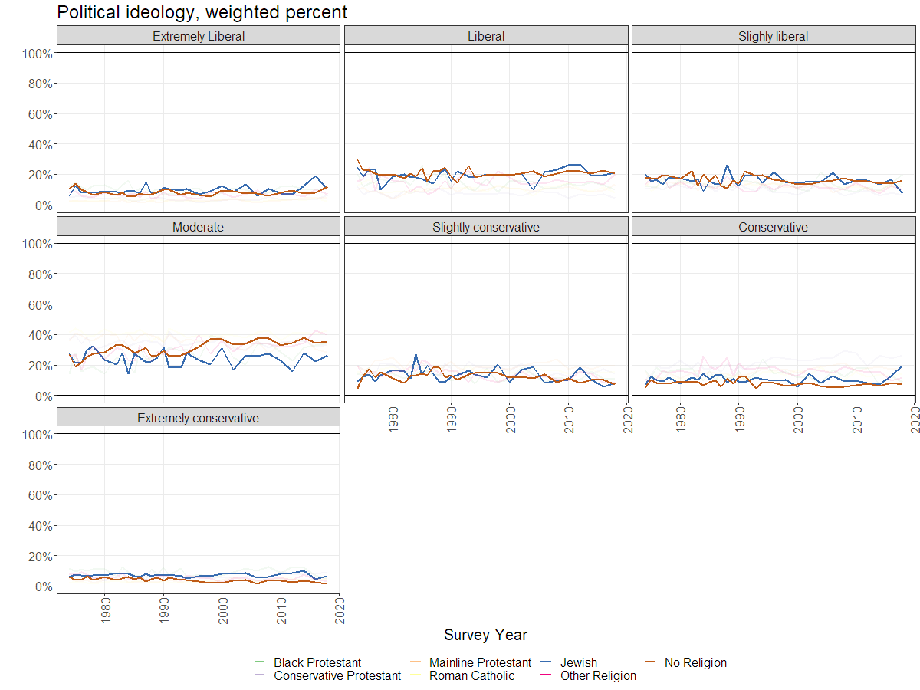
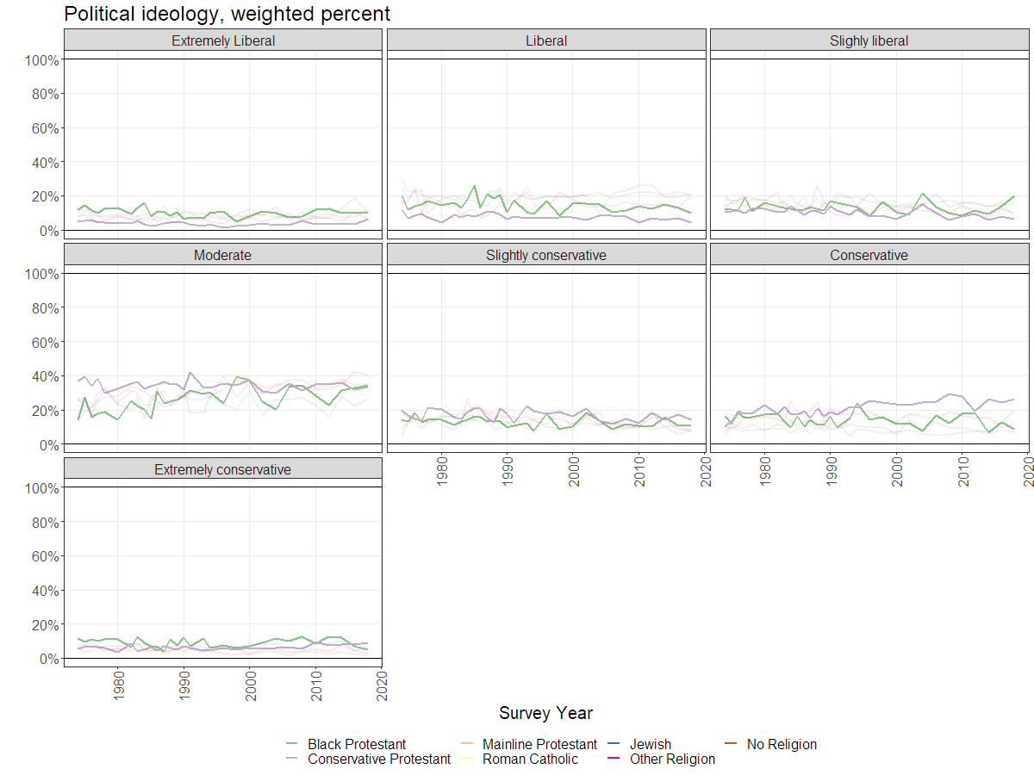
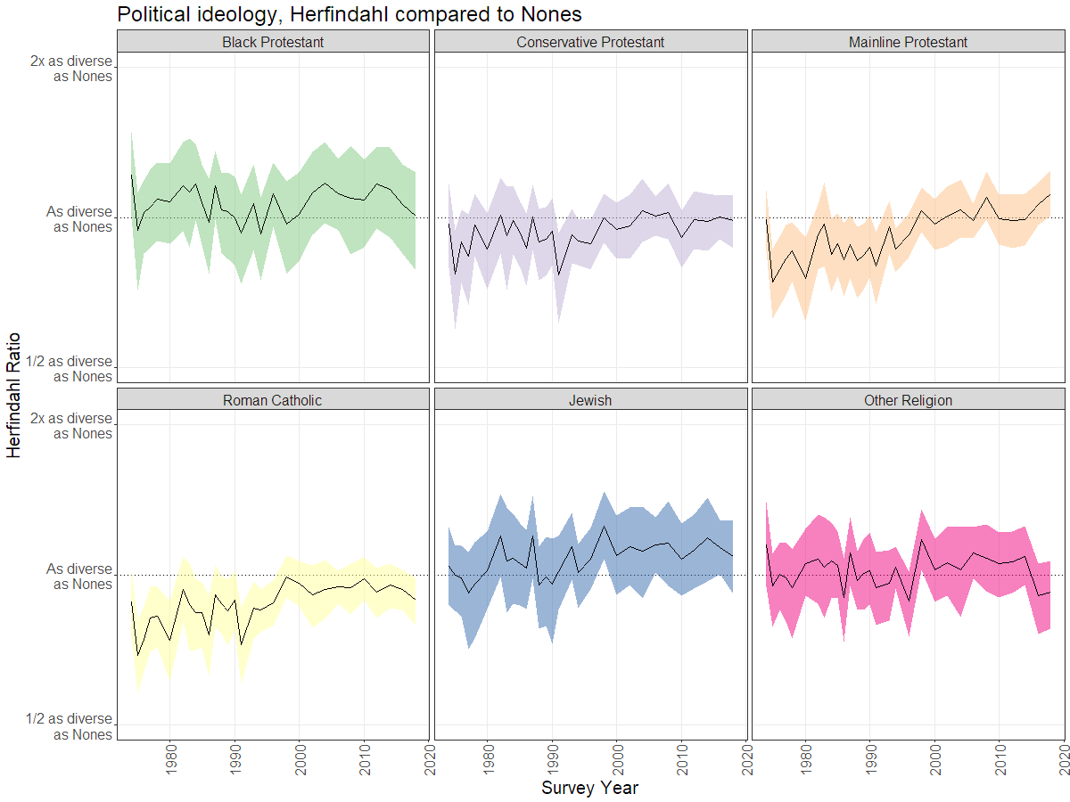
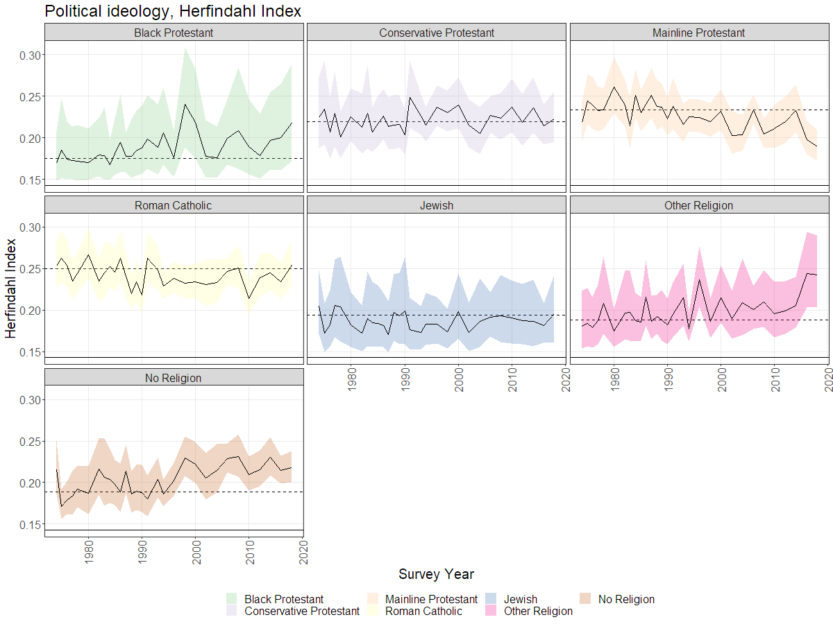
Political ideology

Slide 27
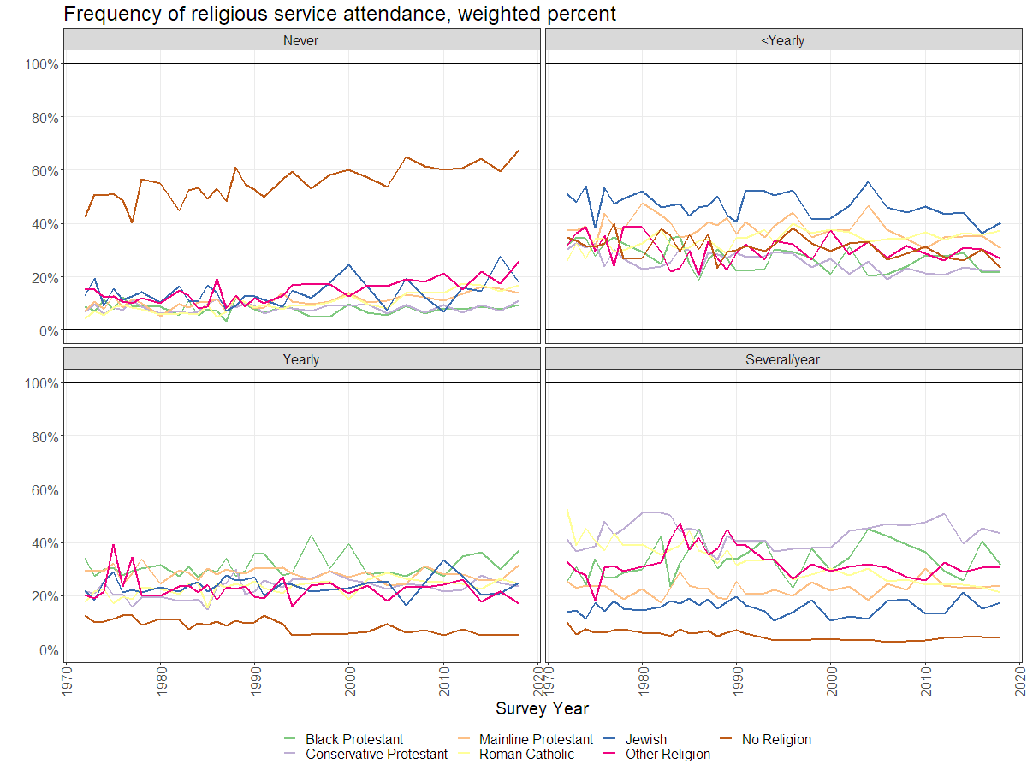
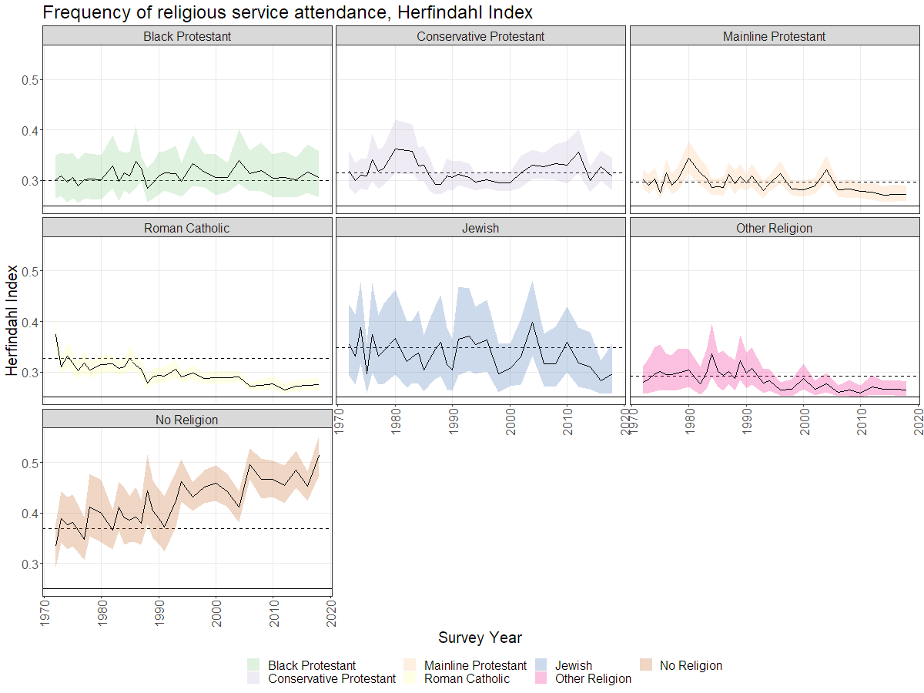
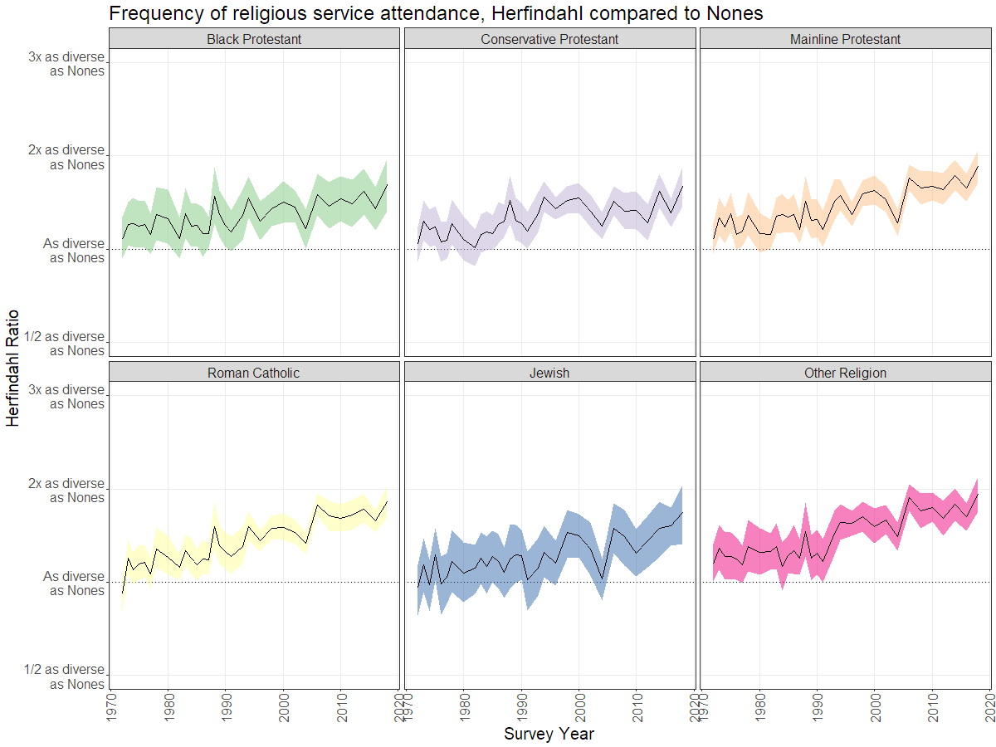
Frequency of religious service attendance

Slide 28
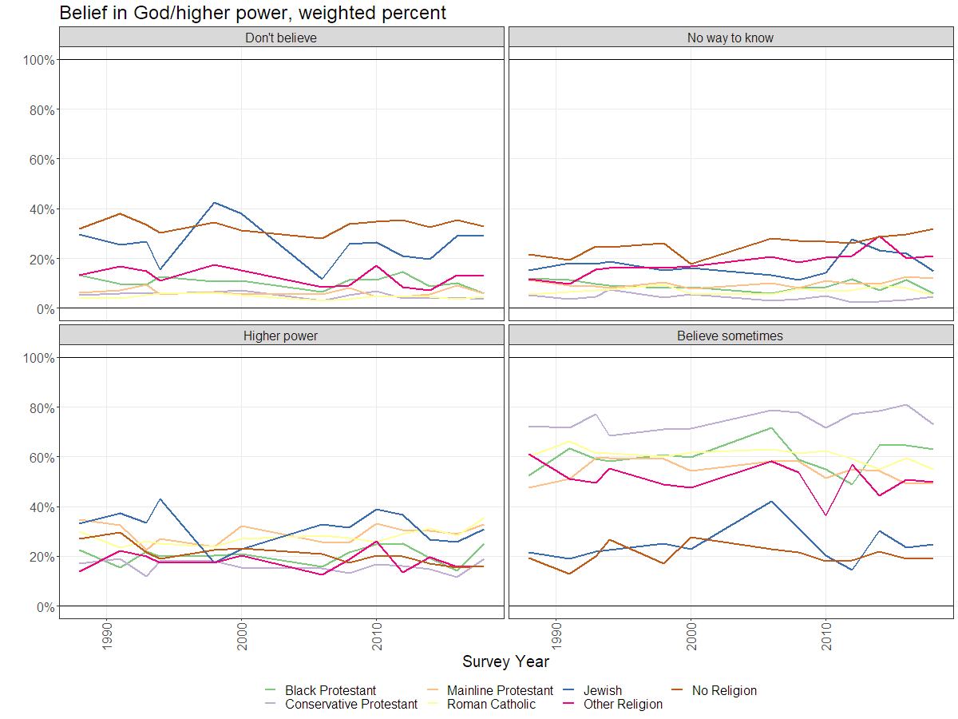
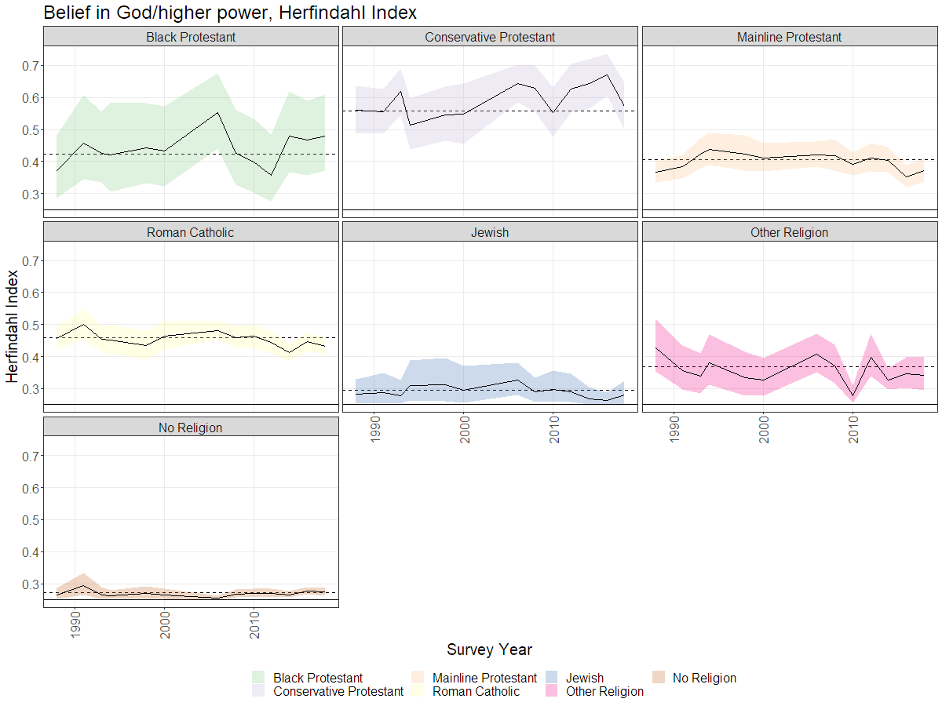
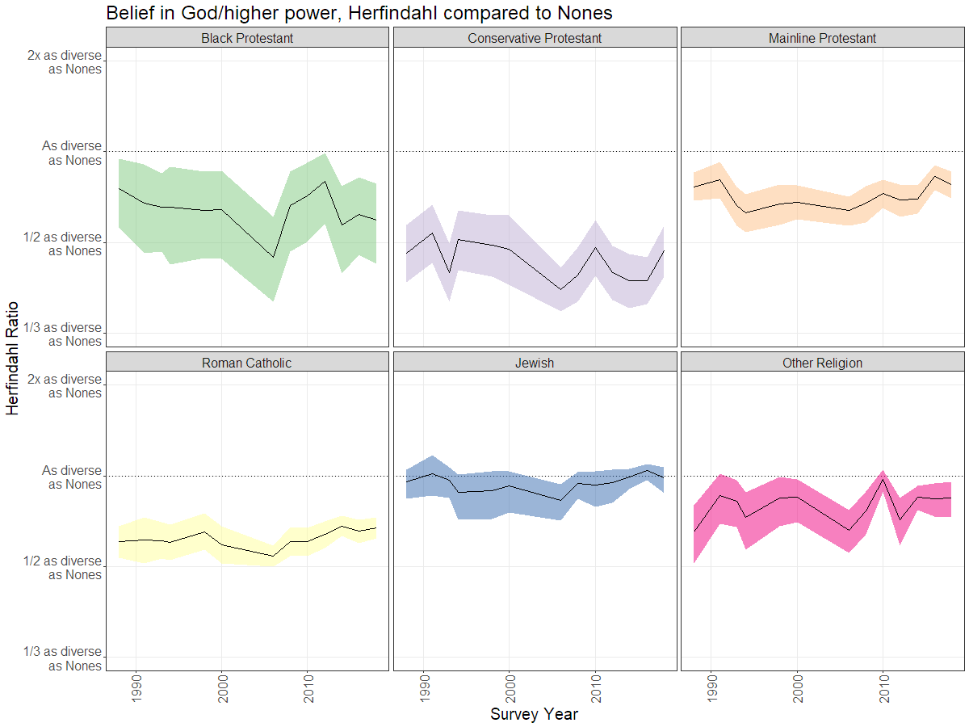
Belief in God/higher power

Slide 29
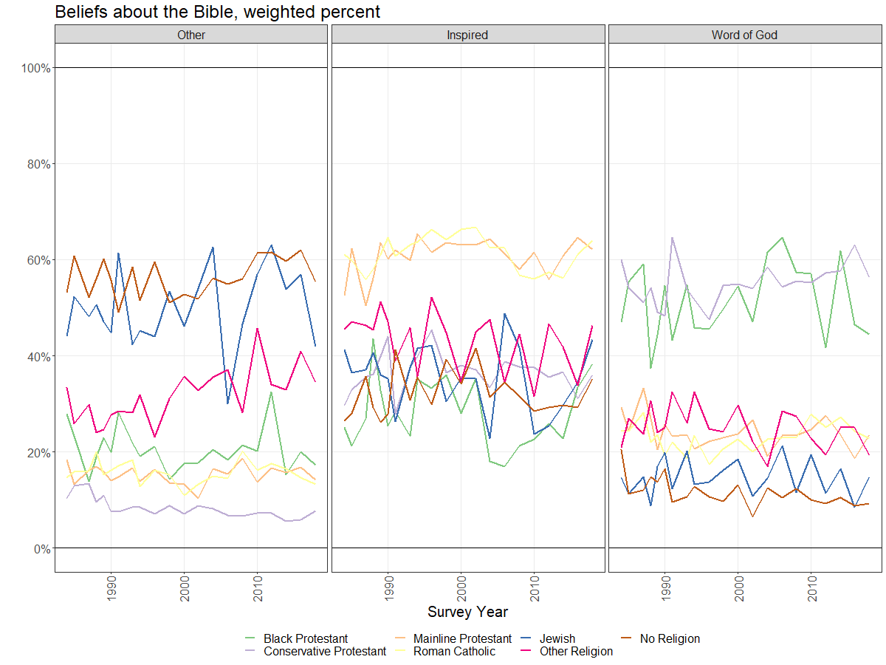
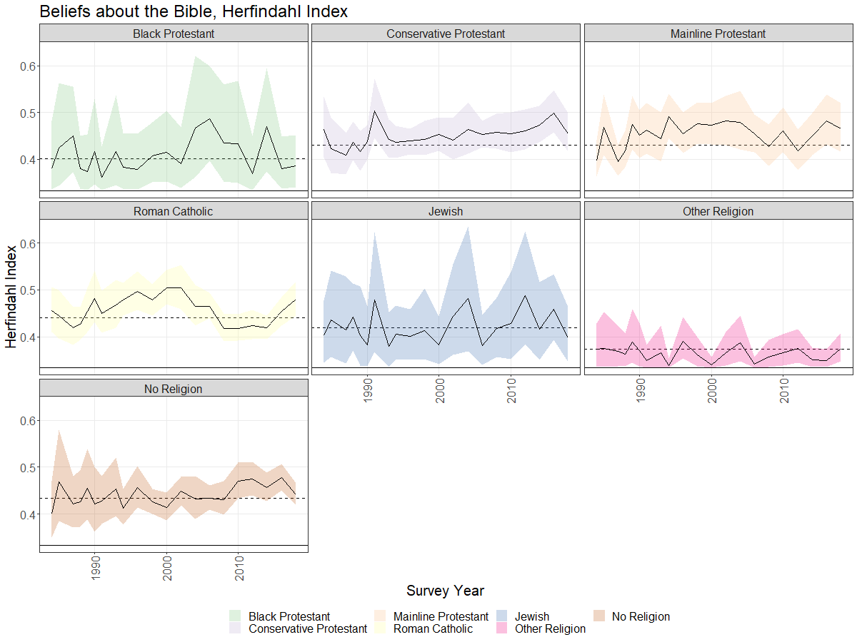
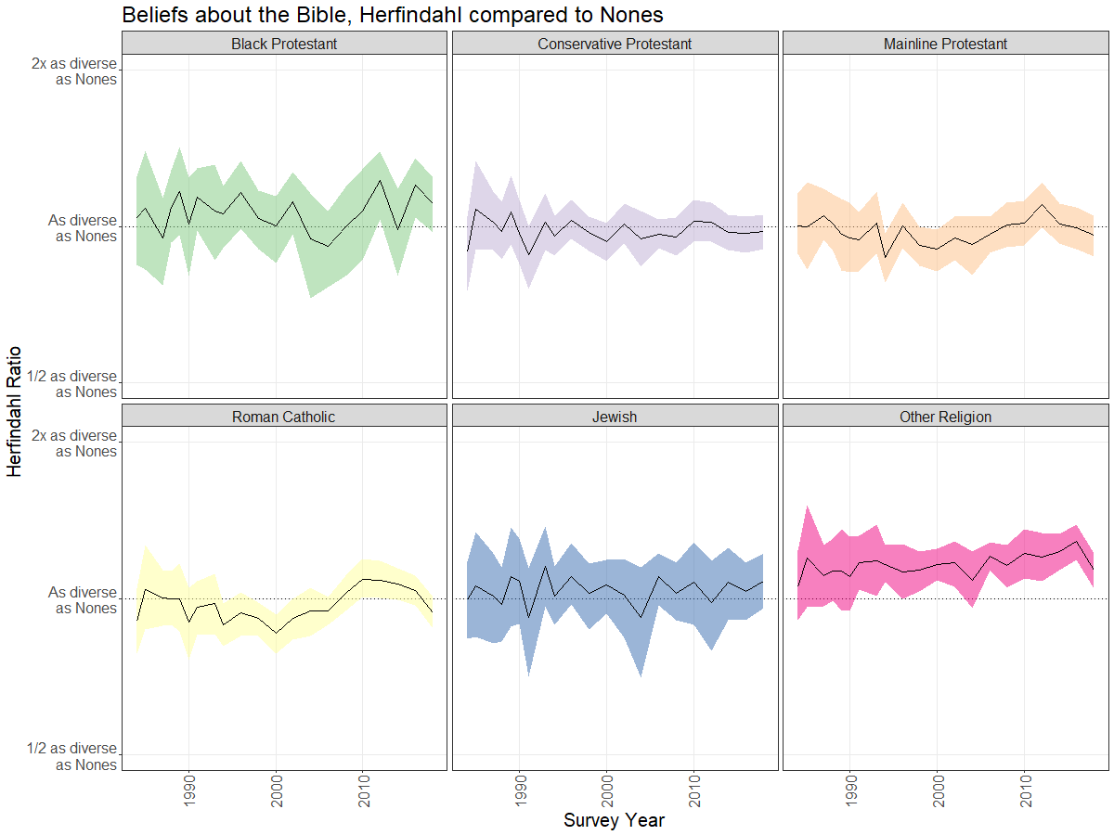
Beliefs about the Bible

Slide 30
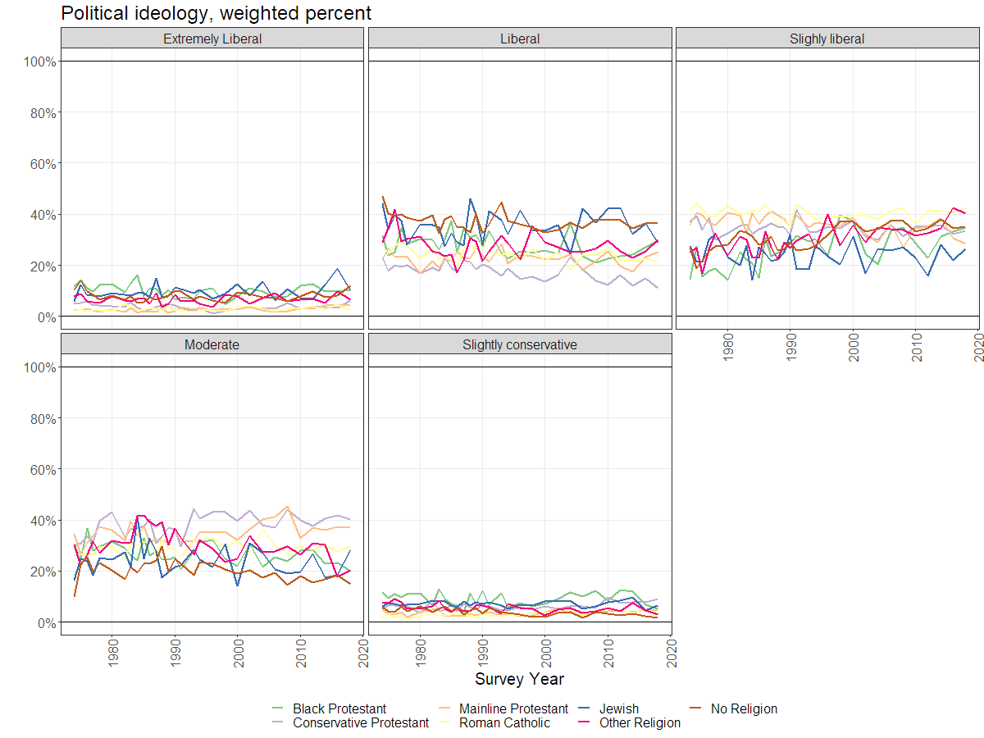
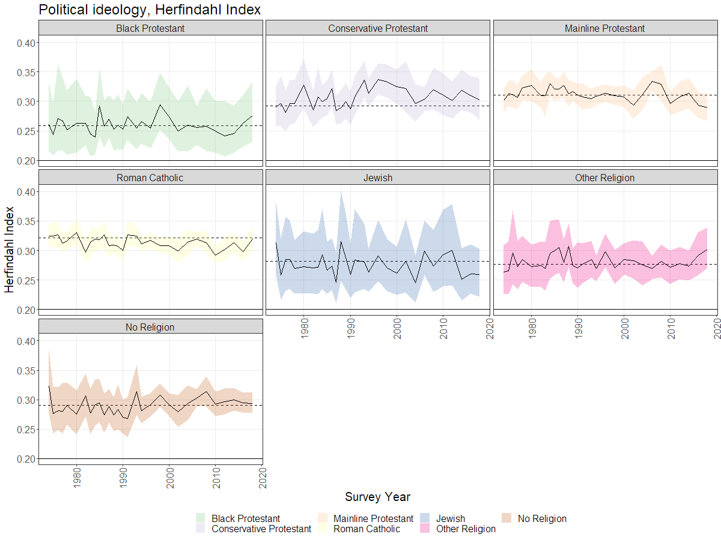
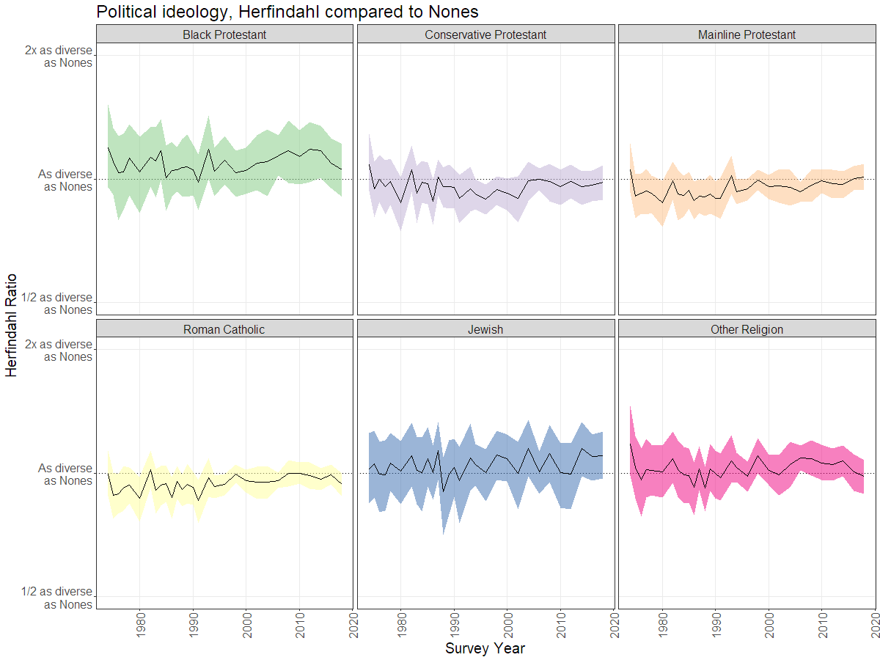
Political ideology

